Slide 1

Recipes and Meal Ideas
Thrive Weight Loss
www.ThriveWeightLoss.com

Slide 2

How much weight have you lost?
What percentage body fat have you lost?
How is your DMO?
www.ThriveWeightLoss.com
www.ThriveWeightLoss.com

Slide 3
To meet your goals, you need to follow the
Thrive Daily Method of Operation:
Attend Class
Journal
Portion Plate 6-8 inches
Rebound Meals
Walk 5/10/15 miles per week
Survival Kit
www.ThriveWeightLoss.com

Slide 4
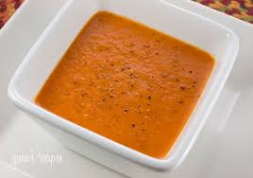
Roasted Red Pepper Soup
Ingredients:
24 ounce jarred roasted peppers, packed in water; drain
4 cups of low sodium chicken broth
1 Teaspoon of Dried Oregano
Olive Oil Cooking Spray
16 Large Shrimp; peeled and deveined
1/8 teaspoon of ground black pepper
2 teaspoons of TCO Oil
1 Clove Garlic; quartered
2 Tbsp of Basil
1/2 P28 Bagel
www.ThriveWeightLoss.com

Slide 5
Roasted Red Pepper Soup
Directions:
In a food processor blender puree red peppers and 2 cups of broth until smooth. Transfer to saucepan and add remaining 2 cups of broth. Stir to combine and bring to a gently boil. Simmer and stir occasionally.
Add Olive Oil flavored cooking spray to TCO Oil in a non-stick frying pan. Cook shrimp until pink and done in TCO Oil and Olive Oil.
Remove soup from heat. Stir in basil. Ladle Soup into serving bowls; top with shrimp.
This is a Perfect Pairing. It can be served without the P28 Bread. You can have up to 2 Cups as a Meal. Pour over 1/2 P28 Bagel for a yummy Perfect Pairing!
www.ThriveWeightLoss.com

Slide 6
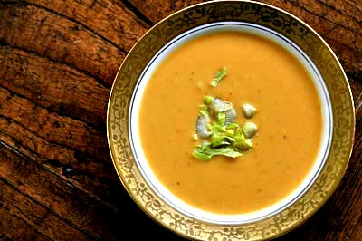
Peanut and Sweet Potato Soup
Ingredients:
11/2 TCO Oil
2 Cloves of Garlic; minced
1 Large yellow onion
1 tbsp of ginger
4 cups of low sodium vegetable broth
4 cups of diced tomatoes
2 cups of butternut squash; peeled and diced
1/2 cup of Better N Peanut Butter
2 Tsp of cumin
1/4 teaspoon of salt
1/4 teaspoon of cayenne pepper
1/4 teaspoon of cinnamon
6 cups of chopped Swiss chard
www.ThriveWeightLoss.com
www.ThriveWeightLoss.com

Slide 7
Peanut and Sweet Potato Soup
Directions
In a large saucepan heat oil on medium heat. Add garlic, onion, and ginger and cook, stir often, about 3 minutes.
Stir in broth, tomatoes, 1 cup water, butternut squash, peanut butter, cumin, salt, cayenne and cinnamon. Bring to boil, then reduce heat and cover. Stir occasionally until butter nut squash is tender, about 12 minutes.
Stir in chard and simmer until wilted, about 2 minutes. Ladle soup into bowls.
You are using butternut squash as your sweet potato substitute. This is a Superfood plus a 2 and is delicious. Up to 2 cups is a meal.
www.ThriveWeightLoss.com

Slide 8
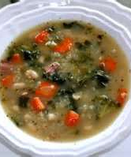
Kale and Quinoa Soup
Ingredients:
1 tbsp of TCO Oil
1 yellow onion; chopped
4 carrots, peeled and sliced
2 cloves of garlic; minced
1 whole tomato, chopped
2 Cups cooked quinoa
1 tsp of cumin
1/4 teaspoon of turmeric
1/4 teaspoon of salt
1/2 teaspoon of black pepper
6 cups chopped kale, stems removed
www.ThriveWeightLoss.com

Slide 9
Kale and Quinoa Soup
Ingredients:
In a stockpot heat oil on medium heat. Add onion and sauté, stir for 3 minutes. Add carrots and sauté until soft, about 5 minutes. Stir in garlic, tomato, quinoa, cumin, turmeric, salt and pepper. Reduce to medium heat. Add 4 cups of water cover and simmer for 10 minutes. Add Kale and cook until kale turns bright green, about 5 minutes.
This is a category 2+3. You can have 1 cup as a snack or add to a category 1 for a complete meal.
www.ThriveWeightLoss.com

Slide 10
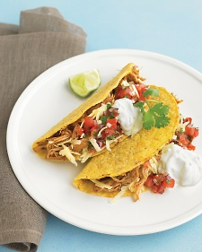
Chile Chicken Tortillas with Avocado Cream
TCO Oil
12 ounce boneless skinless chicken breasts, cut into thin strips
1 tbsp of chile powder
4 La Tortilla Factory Tortillas
3 cups of Romaine Lettuce
1 Green Bell Pepper, thinly sliced
1/2 cup of thinly sliced red onion
1 lime quartered
Avocado Cream
1 Avocado
Juice of 1 Lime
1 Clove of Garlic Peeled
1/4 cup of low fat sour cream
2 Tbsp of chopped cilantro leaves
1/4 teaspoon sea salt
www.ThriveWeightLoss.com

Slide 11
Chile Chicken Tortillas with Avocado Cream
Directions:
Combine all avocado cream ingredients in a blender and puree until smooth. You can add water for a different consistency. Cover and refrigerate. It is best served after refrigerated and up to 24 hours later.
Using TCO Oil in a non stick skillet add chicken that is seasoned with chile powder. Saute until done.
Crisp your tortilla in TCO Oil and then add chicken and lettuce. Spoon about 2 Tbsp of Avocado Cream on top of Tacos! Delicious. Eat only 1 Tortilla with filling as a meal.
This is a 1+2+TCO with a condiment.
www.ThriveWeightLoss.com

Slide 12
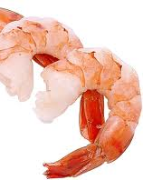
Shrimp Scampi on P28 Flat bread
2 Tbsp of ground flaxseed
1/4 teaspoon of salt
TCO Oil
1 tbsp of ghee butter
1 shallot, chopped
3 cloves of garlic, minced
1 pound of shrimp peeled and deveined; tails removed
1/4 cup of white cooking wine
1/2 cup of grape tomatoes
1/2 cup of low fat parmesan cheese
2 tbsp of parsley
www.ThriveWeightLoss.com
www.ThriveWeightLoss.com

Slide 13
Shrimp Scampi on P28 Flat bread
Directions:
In a skillet heat butter on medium. Add shallot and sauté, stirring often, about 3 minutes. Add garlic and saute. Add shrimp and cook until pink or opaque. Takes about 2-4 minutes to cook shrimp. Increase heat to high and add wine for 2 minutes. Liquid will evaporate.
Add 1/2 of a P28 flat to another skillet with TCO Oil lining bottom of the pan. Brown both sides for 1 minute and then add the shrimp mixture to the top of the flat.
This makes about 2 servings. This is a Superfood or a Perfect Pairing. Consume no more than what will fit on your portion control plate.
www.ThriveWeightLoss.com

Slide 14

Meal Plan Idea
Breakfast:
  Eggs Florentine with blueberries; fat free feta cheese, egg whites, spinach, 1/2 cup of blueberries on the side.
  Sauté your spinach in TCO Oil about 4 minutes. Pour Egg Whites onto spinach until eggs are cooked. Sprinkle Fat Free Feta Cheese. Have Blueberries on the side.
  This is a 1+2+5 combination.
  Thrive Approved French Toast with Walden Farms Pancake Syrup
  T7 shake; 2 Scoops of Vanilla and add 2 Tbsp of Better N Peanut Butter; use Egg Whites International as a base or water.
Lunch:
  Tuna Fish Sandwich; use TCO Mayo or Light Mayo and of course mustard. Put on Category 2 Bread or use 1/2 of P28 Flat as a wrap. Add lettuce or any other category 2 that you desire.
  Carbonada Pasta with Walden Farms Calorie Free Alfredo sauce. Sprinkle with Fat Free Feta Cheese. This is a slow digesting pasta and can be used as a 1+2+3. Have 1.5 Cups as a meal. Since this is really considered a Superfood you can add a category 2 salad.
  Quest Bar
www.ThriveWeightLoss.com

Slide 15
Meal Plan Idea
Dinner:
  1 Slice of P28 Bread with 1 Package of Vegetarian Chili from Robards company. Add 1 Fat Free Turkey Frank if desired. Cook frank and heat bread in TCO Oil. Prepare chili as specified on the package. You can just add the chili for a type of sloppy joe or have a chili dog by adding the frank.
  Lemon Pepper Fish and Squash medley
  Grilled Chicken with a stuffed pepper. Stuffing is quinoa. Add a little salsa. Stubbs chicken marinade is excellent.
Snack:
  Healthsmart Pecan Clusters
  Protein Chips or Protein Krinkles
  Fiber Gourmet Crackers
Freebies:
  Spark Popsicles
  Spark Egg Poppers
www.ThriveWeightLoss.com
www.ThriveWeightLoss.com

Slide 16

Begin With The End In Mind

